Slide 1
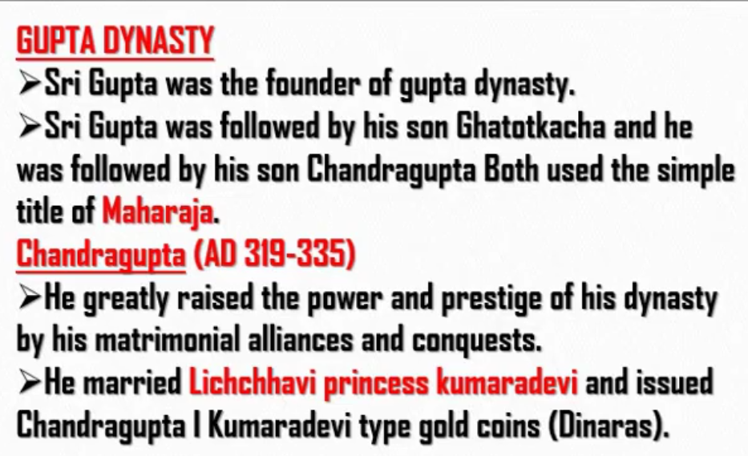
Sri Gupta is the father of Ghatotkacha
Ghatotkacha is the father of Chandragupta I
Both Ghatotkacha and Chandragupta observed the title “Maharaja”
Lichchhavi is the name of the placessss

Slide 2
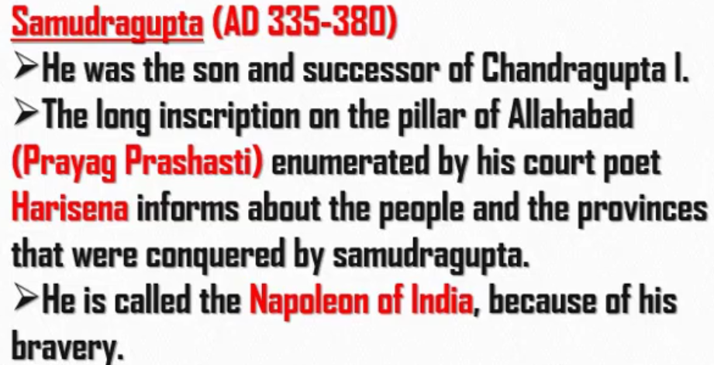
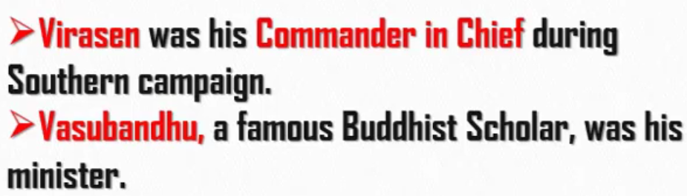

Slide 3
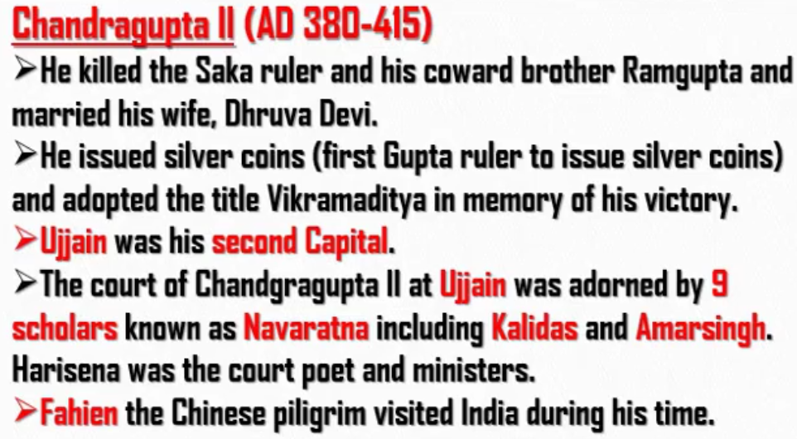
Samudragupta had two sons.
Elder one Ramgupta.
Younger one Chandragupta II
Ramgupta was the successor of Samudragupta.
Ramgupta was coward and he was killed by his younger brother Chandragupta II
In exam, question will be asked as “Who gave the patronage to Kalidas and Amarsingh?”
Answer : “Chandragupta II”
Name the Chinese piligrim who visited India during the rule of Chandragupta II (asked 9-10 times in exam)
Answer : “Fahien”

Slide 4
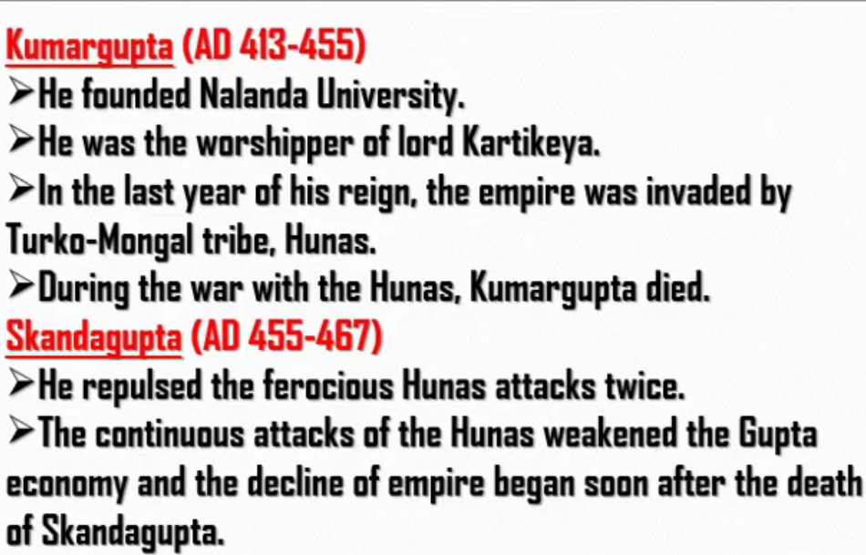
The name of Turko-Mongal tribe is Hunas

Slide 5
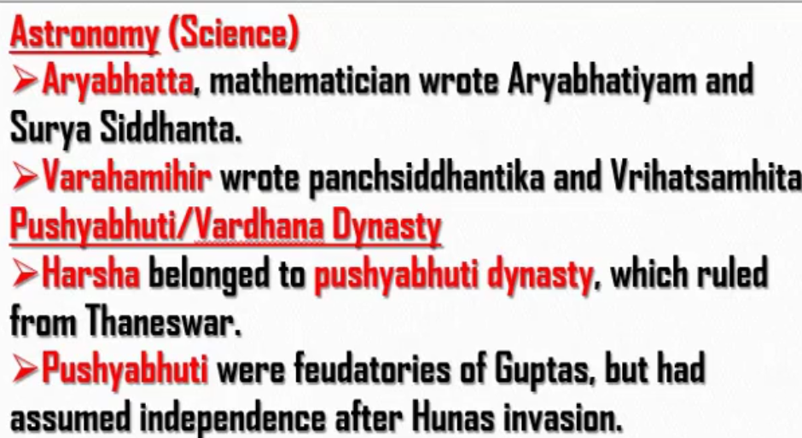
Pushyabuthi dynasty is also known as Vardhan dynasty.
So, Harsha is known as Harsha Vardhana.
Pushyabuthis were samanthas of Guptas.
When Guptas declined due to Hunas, Pushybutis became free (got independence).

Slide 6
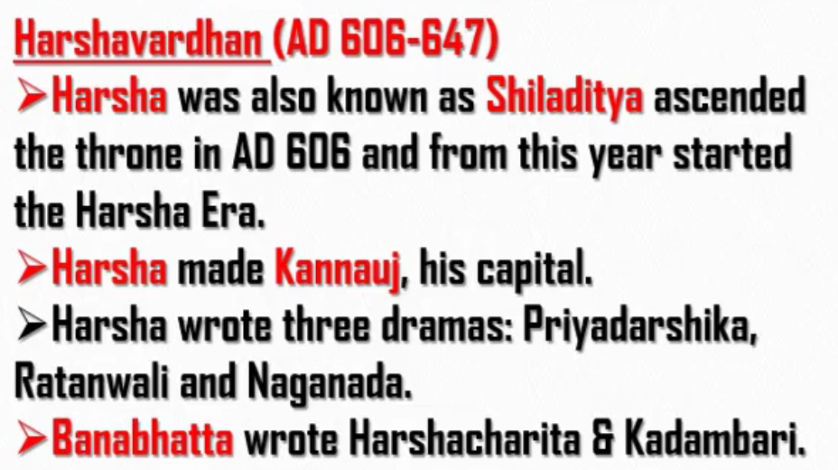
Thaneswar was the capital of Harsha Vardhana when he was feudatory of Guptas
When he became independent from Guptas after they were declined by Hunas, Harsha Vardhana changed his capital to Kannauj located on the banks of Ganga.
Harshavardhana gave patronage to Banabhatta (i.e. Court poet – Astana Kavi)

Slide 7
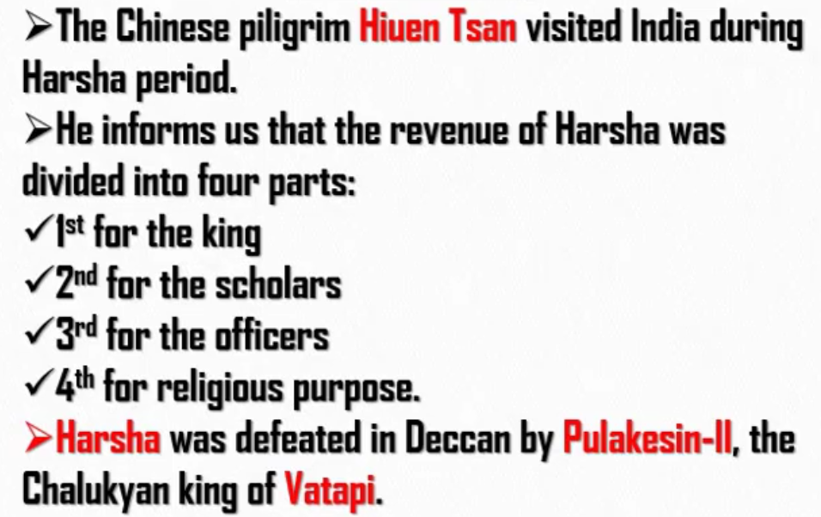
He – Hiuen Tsan
Harshavardhana – Hieun Tsan
Chandragupta II – Fahein

